Slide 1
BIG DATA
PRESENTATION BY
N.Manikandan
L.Jacop Antony
S.Jeevanantham
S.Saravanaperumal
S.Vishwa

Slide 2
CONTENTS
1
PART
What is data visualization?
2
PART
Why is data visualization important?
3
PART
Using plots and charts in data visualization

Slide 3
BIG DATA
Using plots and charts in data visualization

Slide 4
Histogram
Main screen selections
On the main screen, after selecting the data column to be analyzed, you can directly view different charts, and all the required data calculation values are displayed in the chart for reference. Of course, the data can also be selected and replaced according to your requirements. Various parameters can also be selected and adjusted at any time.

Slide 5
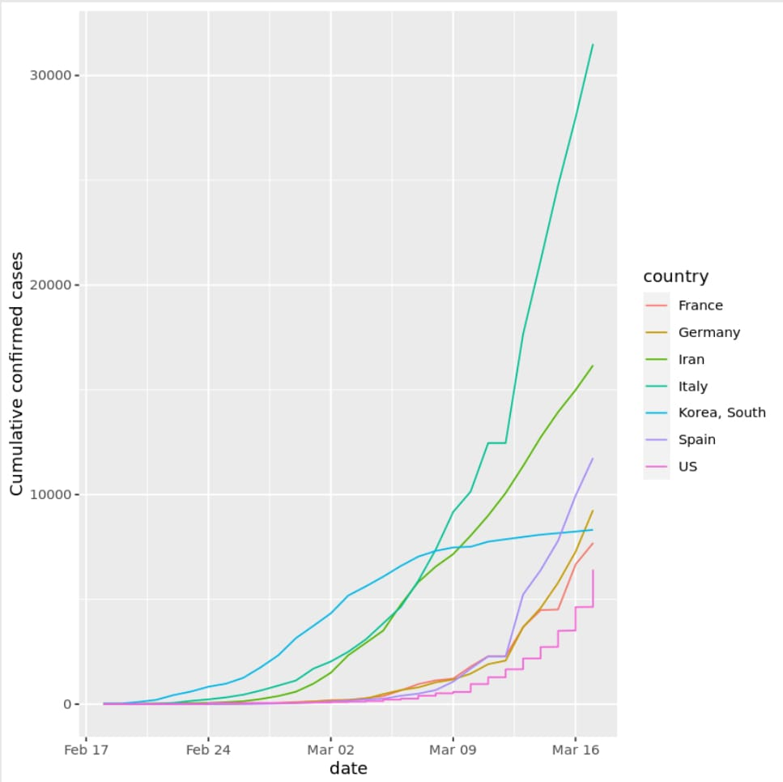
Histogram
Here we use the histogram as an example to show how different parameter settings allow you to get the charts you need.

Slide 6
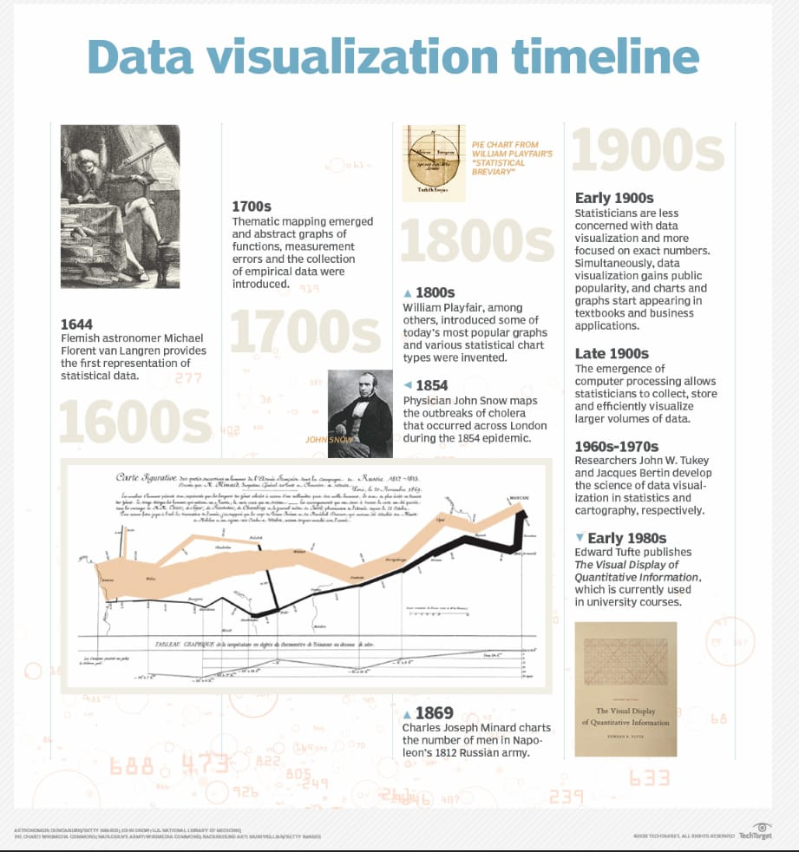
What is data visualization?
Data visualization is the practice of translating information into a visual context, such as a map or graph, to make data easier for the human brain to understand and pull insights from. The main goal of data visualization is to make it easier to identify patterns, trends and outliers in large data sets. The term is often used interchangeably with others, including information graphics, information visualization and statistical graphics.

Slide 7
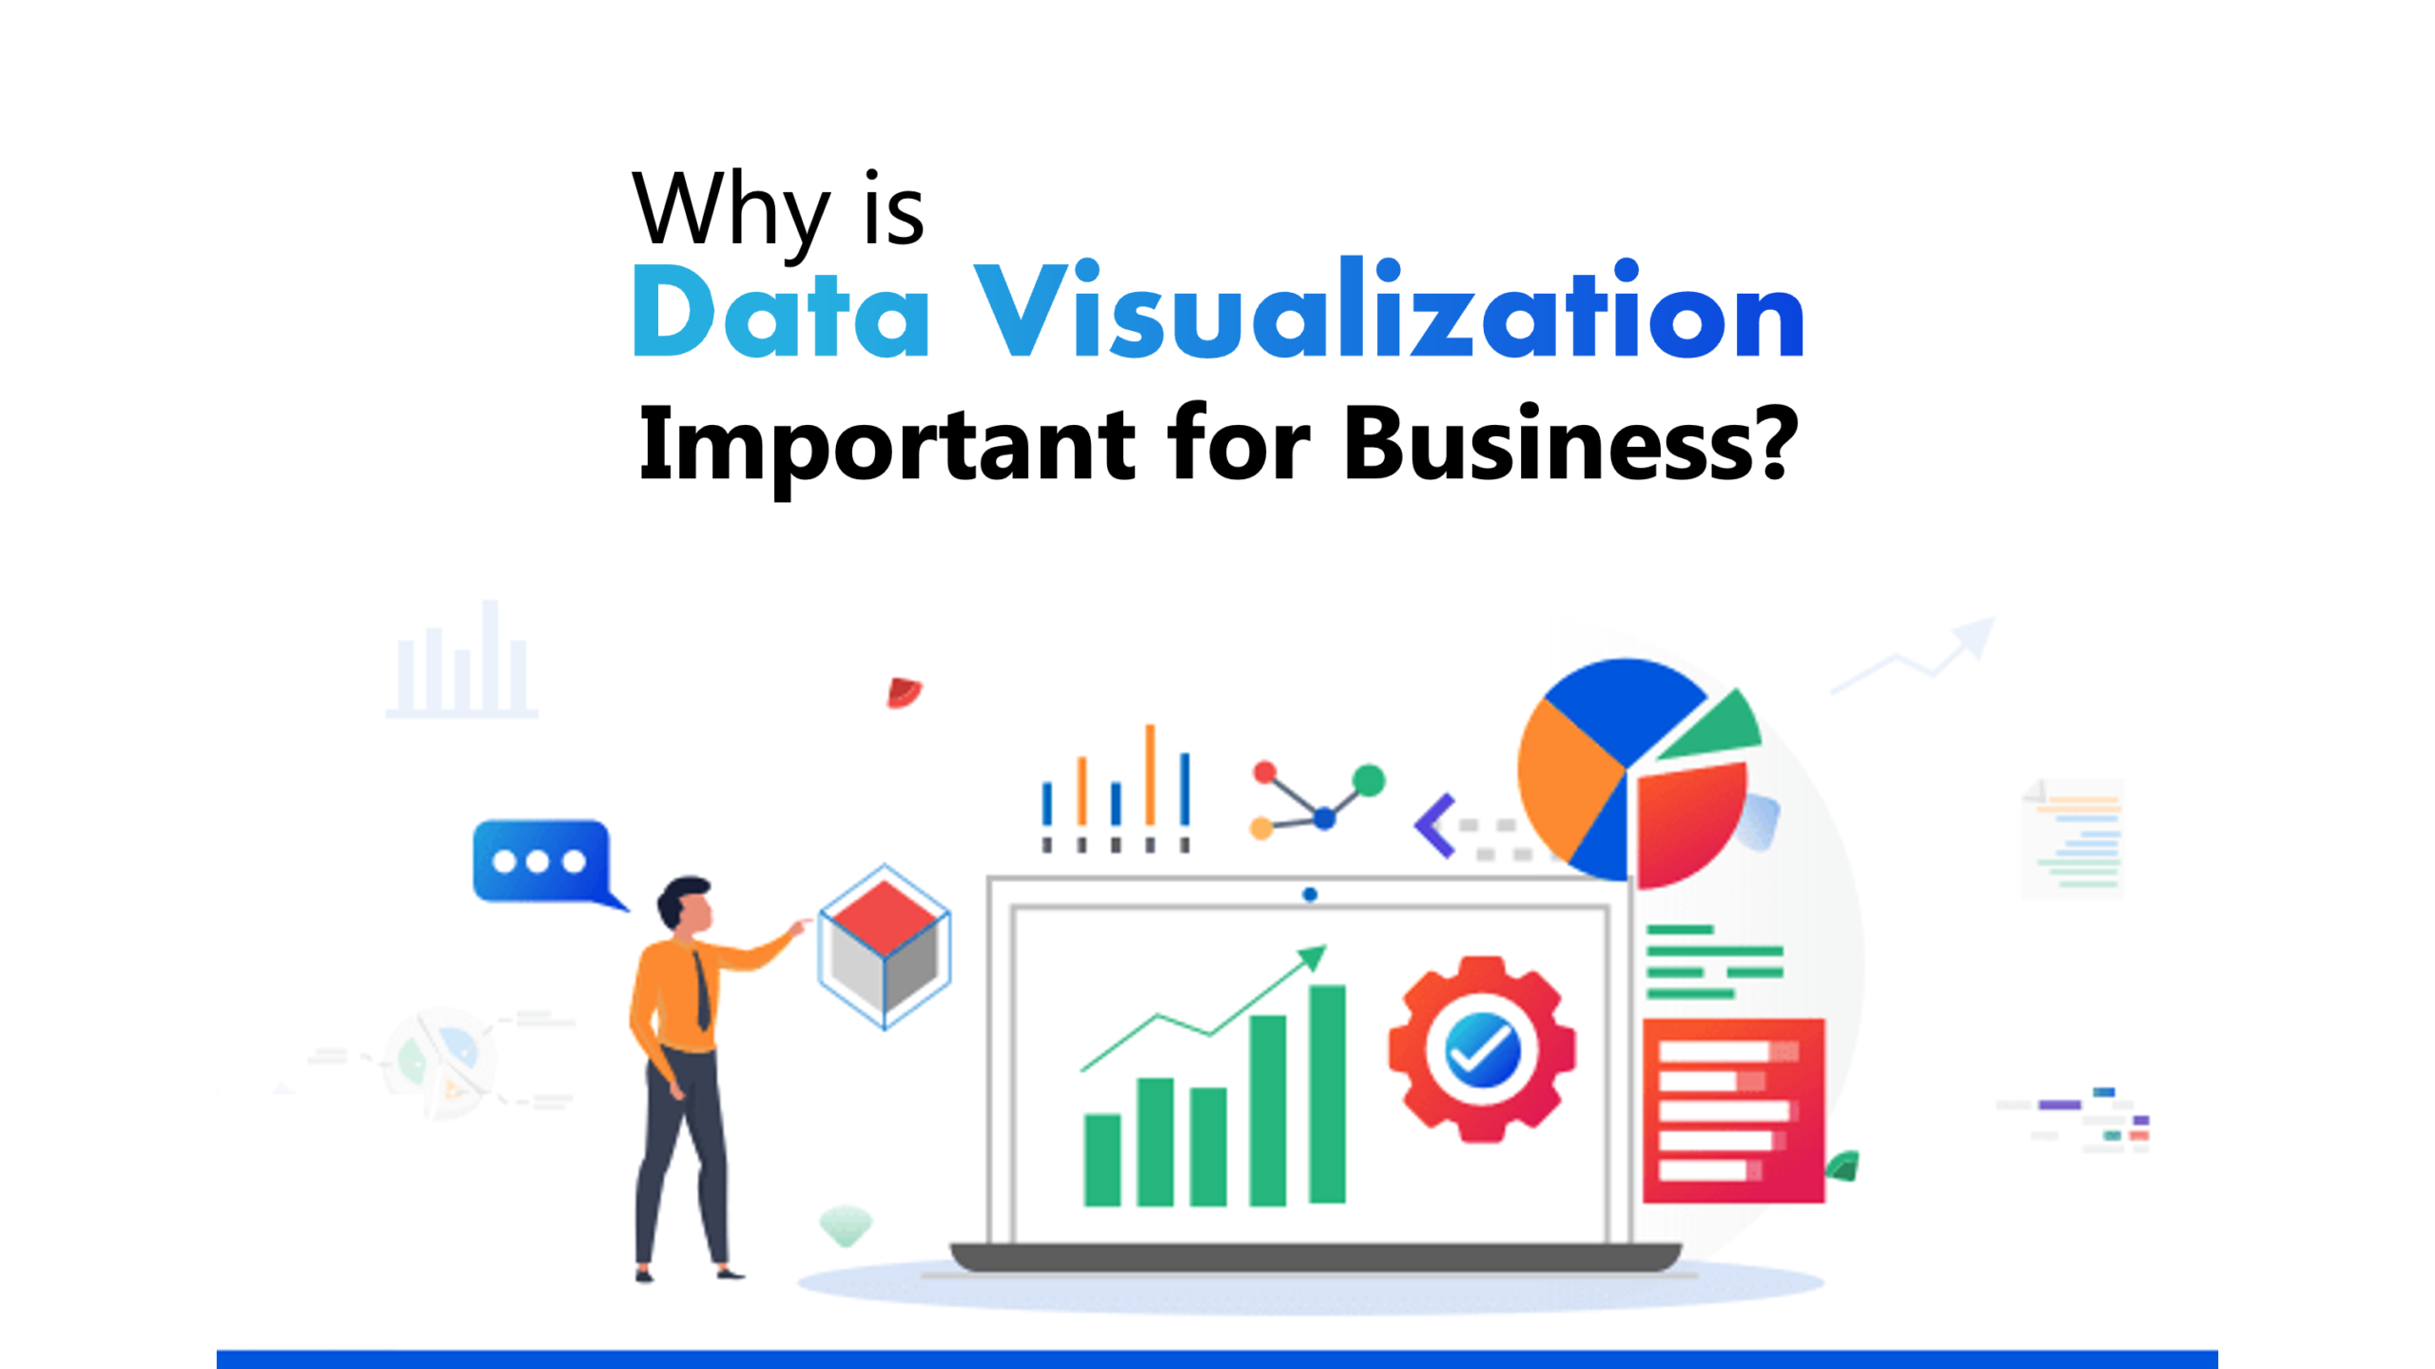
Why is data visualization important?
Data visualization provides a quick and effective way to communicate information in a universal manner using visual information. The practice can also help businesses identify which factors affect customer behavior; pinpoint areas that need to be improved or need more attention; make data more memorable for stakeholders; understand when and where to place specific products; and predict sales volumes.

Slide 8
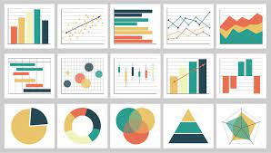
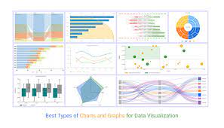
Using plots and charts in data visualization
Plot
Chart

Slide 9
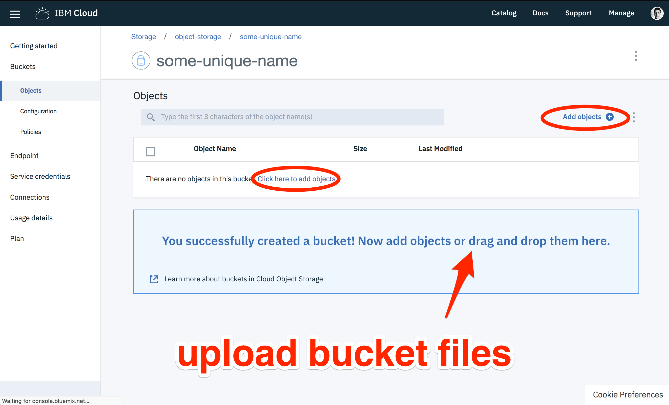
YOUR TITLE HERE
Presentation are communication tools that can be used as demontrations, lectures, reports, and more. it is mostly presented before an audience. Presentation are communication tools that can be used as demontrations, lectures, reports, and more. Presentations are communication tools that can be used as demonstrations.

Slide 10
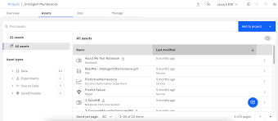

Slide 11
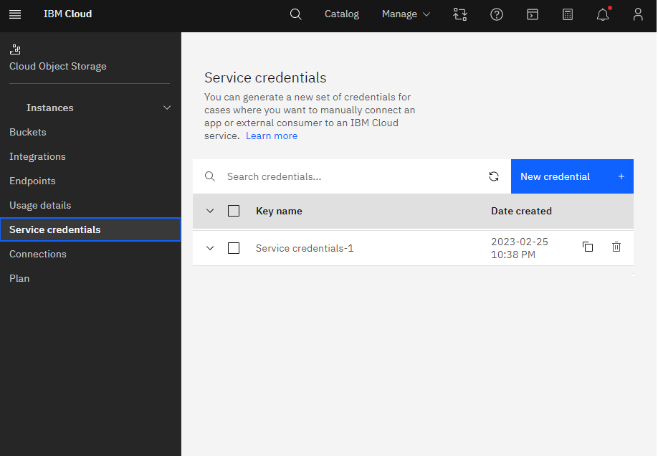

Slide 12
THANK YOU
.

